Slide 1
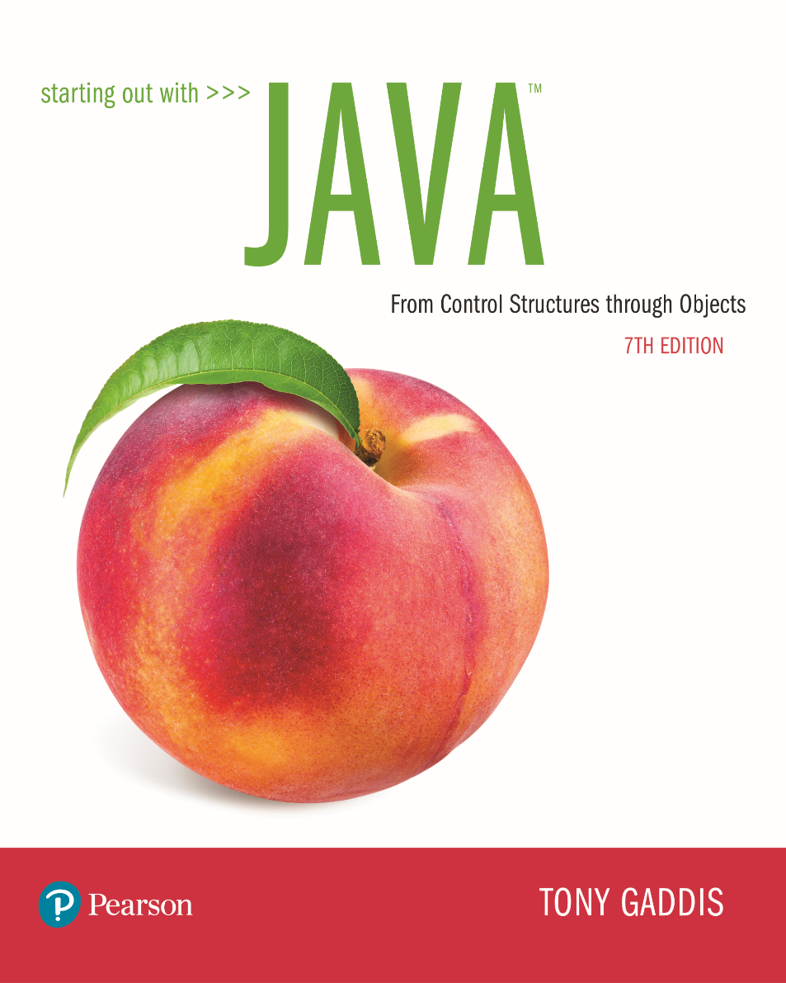

Slide 2
Examples’ Source Code
Source Code for examples presented in these slides can be found on:
Blackboard->Course Content->Source Code Of The Book Examples

Slide 3
Module 18 Topics
Module 18 discusses the following main topics:
Selection Sort
Insertion Sort
Linear Search
Binary Search
Arrays.sort
Comparable interface
7.8 The sequential search algorithm
7.11 The Selection Sort and Binary Search Algorithms

Slide 4
Selection Sort
In a selection sort:
The smallest value in the array is located and moved to element 0.
Then the next smallest value is located and moved to element 1.
This process continues until all of the elements have been placed in their proper order.

Slide 5
Selection Sort
Sorts an array by repeatedly finding the smallest element of the unsorted tail region and moving it to the front
Slow when run on large data sets
Example: sorting an array of integers
11 | 9 | 17 | 5 | 12

Slide 6
Sorting an Array of Integers
11 | 9 | 17 | 5 | 12
Find the smallest and swap it with the first element
Find the next smallest. It is already in the correct place
Find the next smallest and swap it with first element of unsorted portion
Repeat
When the unsorted portion is of length 1, we are done
5 | 9 | 17 | 11 | 12
5 | 9 | 17 | 11 | 12
5 | 9 | 11 | 17 | 12
5 | 9 | 11 | 12 | 17
5 | 9 | 11 | 12 | 17

Slide 7
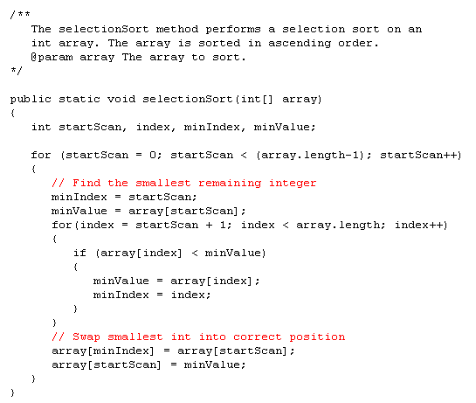

Slide 8

What steps does the selection sort algorithm go through to sort the sequence 6 5 4 3 2 1?
Answer:
1 | 5 | 4 | 3 | 2 | 6
1 | 2 | 4 | 3 | 5 | 6
1 | 2 | 3 | 4 | 5 | 6

Slide 9
Insertion Sort
The approach of Insertion Sort:
pick any item and insert it into its proper place in a sorted sublist
repeat until all items have been inserted
In more detail:
consider the first item to be a sorted sublist (of one item)
insert the second item into the sorted sublist, shifting the first item as needed to make room to insert the new addition
insert the third item into the sorted sublist (of two items), shifting items as necessary
repeat until all values are inserted into their proper positions

Slide 10
Insertion Sort
Assume initial sequence a[0] ... a[k] is sorted (k = 0):
11 | 9 | 16 | 5 | 7
Add a[1]; element needs to be inserted before 11
9 | 11 | 16 | 5 | 7
Add a[2]
9 | 11 | 16 | 5 | 7
Add a[3]
5 | 9 | 11 | 16 | 7
Finally, add a[4]
5 | 7 | 9 | 11 | 16

Slide 11
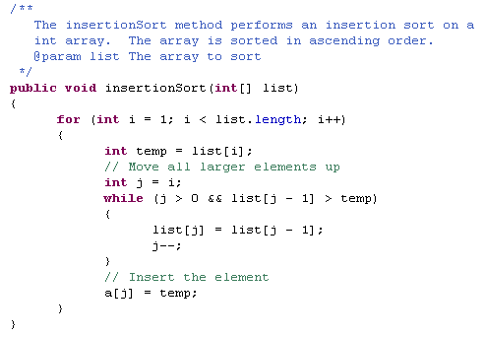

Slide 12


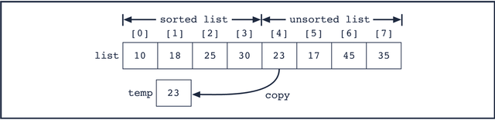
Insertion Sort – another example
After 3 iterations or “passes” of insertion sort

Slide 13
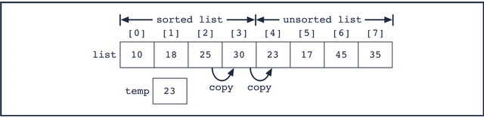
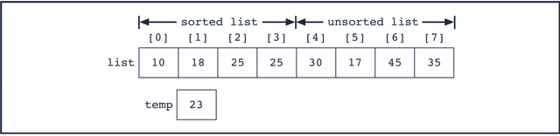
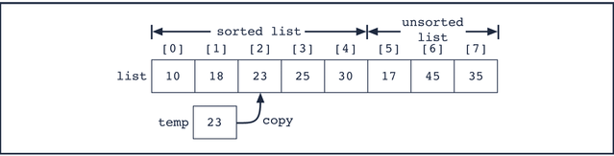

Slide 14
What steps does the insertion sort algorithm go through to sort the sequence 6 5 4 3 2 1?
Answer:
6 | 5 | 4 | 3 | 2 | 1
5 | 6 | 4 | 3 | 2 | 1
4 | 5 | 6 | 3 | 2 | 1
3 | 4 | 5 | 6 | 2 | 1
2 | 3 | 4 | 5 | 6 | 1
1 | 2 | 3 | 4 | 5 | 6

Slide 15
Searching
Searching is the process of finding a target element within a group of items called the search pool
The target may or may not be in the search pool
We want to perform the search efficiently, minimizing the number of comparisons
Let's look at two classic searching approaches: linear or sequencial search and binary search

Slide 16
Linear or sequential search
Linear search: also called sequential search
Examines all values in an array until it finds a match or reaches the end
Uses a loop to:
sequentially step through an array,
compare each element with the search value, and stop when
the value is found or
the end of the array is encountered.
Number of visits for a linear search of an array of n elements:
The average search visits n/2 elements
The maximum visits is n

Slide 17
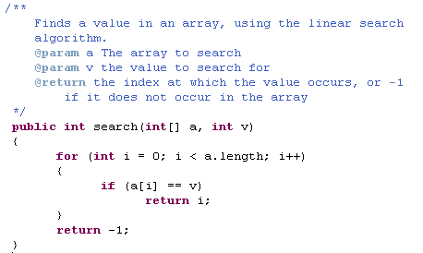

Slide 18
Binary Search
A binary search:
requires an array sorted in ascending order.
starts with the element in the middle of the array.
If that element is the desired value, the search is over.
Otherwise, the value in the middle element is either greater or less than the desired value
If it is greater than the desired value, search in the first half of the array.
Otherwise, search the last half of the array.
Repeat as needed while adjusting start and end points of the search.

Slide 19
Binary Search
Searching for 24
0 1 2 3 4 5 6 7 8 9 10 11 12 13 14
0 2 4 6 8 10 12 14 16 18 20 22 24 26 28
denotes element examined
index
values

Slide 20
Binary Search
Searching for 24
0 1 2 3 4 5 6 7 8 9 10 11 12 13 14
0 2 4 6 8 10 12 14 16 18 20 22 24 26 28
16 18 20 22 24 26 28
denotes element examined
index
values

Slide 21
Binary Search
Searching for 24
0 1 2 3 4 5 6 7 8 9 10 11 12 13 14
0 2 4 6 8 10 12 14 16 18 20 22 24 26 28
16 18 20 22 24 26 28
24 26 28
denotes element examined
index
values

Slide 22
Binary Search
Searching for 24
0 1 2 3 4 5 6 7 8 9 10 11 12 13 14
0 2 4 6 8 10 12 14 16 18 20 22 24 26 28
16 18 20 22 24 26 28
24 26 28
24
denotes element examined
index
values

Slide 23
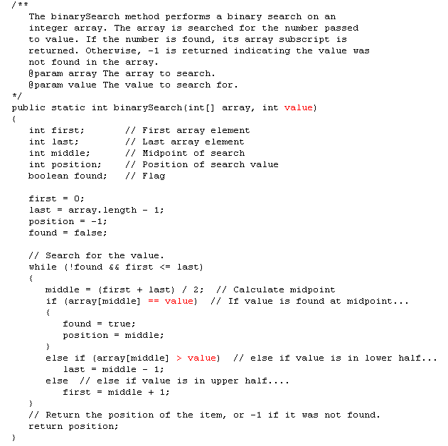

Slide 24
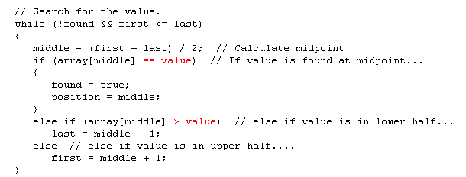
What is the condition that stops the while loop
when there is an unsuccessful search?
When first becomes greater than last

Slide 25
Binary Search
Searching for 7
0 1 2 3 4 5 6 7 8 9 10 11 12 13 14
0 2 4 6 8 10 12 14 16 18 20 22 24 26 28
First
Middle
Last
index
values

Slide 26

Binary Search
Searching for 7
0 1 2 3 4 5 6 7 8 9 10 11 12 13 14
0 2 4 6 8 10 12 14 16 18 20 22 24 26 28
0 2 4 6 8 10 12
First
Middle
Last
index
values

Slide 27
Binary Search
Searching for 7
0 1 2 3 4 5 6 7 8 9 10 11 12 13 14
0 2 4 6 8 10 12 14 16 18 20 22 24 26 28
0 2 4 6 8 10 12
8 10 12
First
Middle
Last
index
values

Slide 28
Binary Search
Searching for 7
0 1 2 3 4 5 6 7 8 9 10 11 12 13 14
0 2 4 6 8 10 12 14 16 18 20 22 24 26 28
0 2 4 6 8 10 12
8 10 12
8
First
Middle
Last
index
values

Slide 29
Binary Search
Searching for 7
0 1 2 3 4 5 6 7 8 9 10 11 12 13 14
0 2 4 6 8 10 12 14 16 18 20 22 24 26 28
0 2 4 6 8 10 12
8 10 12
8
Last
First
index
values

Slide 30
Arrays.sort
The Arrays class contains static sort methods
To sort an array of integers:
int[] a = ... ; Arrays.sort(a);
That sort method uses the Quicksort algorithm
Arrays.sort sorts objects of classes that implement Comparable interface:
public interface Comparable { int compareTo(Object otherObject); }

Slide 31
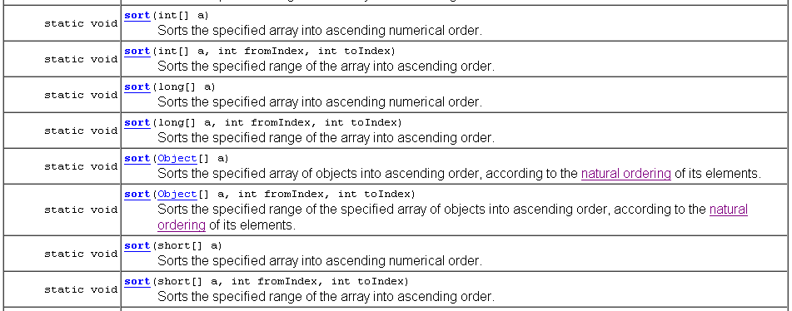
Arrays class
What is natural ordering?

Slide 32
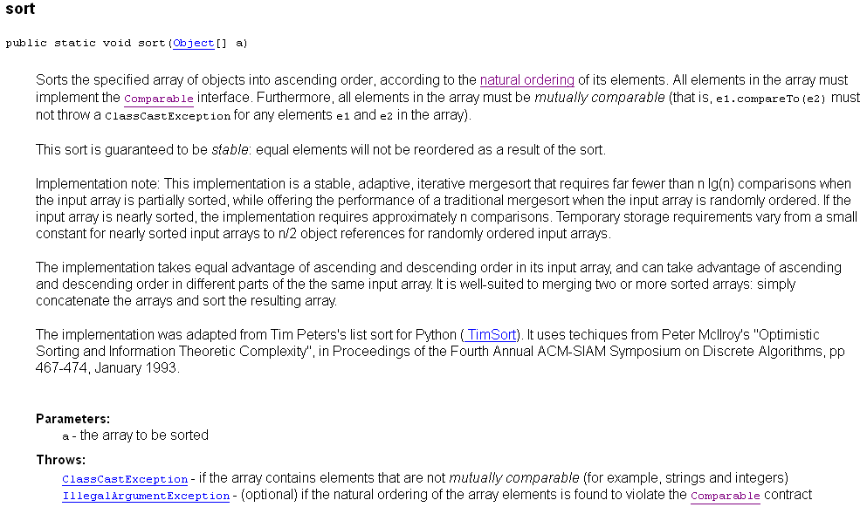

Slide 33
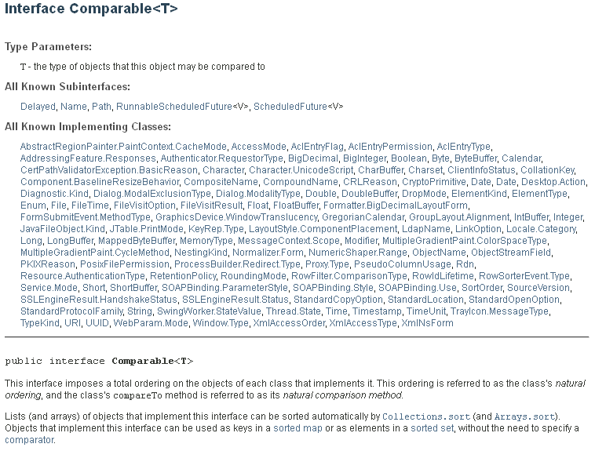

Slide 34
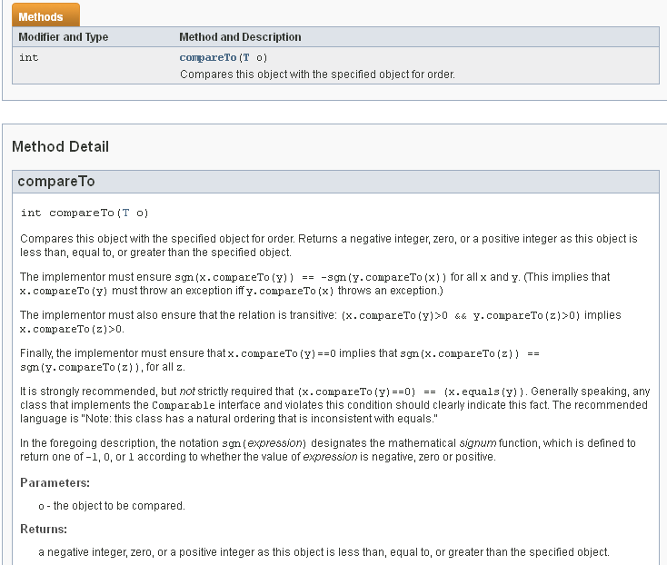

Slide 35
compareTo Method
The call a.compareTo(b) returns
A negative number if a should come before b
0 if a and b are the same
A positive number otherwise
The implementation must define a total ordering relationship
Antisymmetric
If a.compareTo(b) ≤ 0, then b.compareTo(a) ≥ 0
Reflexive
a.compareTo(a) = 0
Transitive
If a.compareTo(b) ≤ 0 and b.compareTo(c) ≤ 0, then a.compareTo(c) ≤ 0

Slide 36
Comparable Interface
Several classes in Java (e.g. String and Date) implement Comparable
You can implement Comparable interface for your own classes:
public class Coin implements Comparable { ... public int compareTo(Object otherObject) { Coin other = (Coin)otherObject; if (value < other.value) return -1; if (value == other.value) return 0; return 1; } ... }
This must be the signature if Comparable is not parameterized

Slide 37
Comparable Interface
You can implement Comparable interface for your own classes:
public class Coin implements Comparable<Coin> { ... public int compareTo(Coin otherObject) { Coin other = (Coin)otherObject; if (value < other.value) return -1; if (value == other.value) return 0; return 1; } ... }
This is the signature if Comparable is parameterized

Slide 38
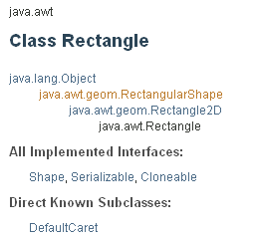
Something to think about
Why can’t the Arrays.sort method sort an array of Rectangle objects?
Answer: The Rectangle class does not implement the Comparable interface.

Slide 39
What steps would you need to take to sort an array of BankAccount objects by increasing balance?
Answer: The BankAccount class needs to implement the Comparable interface. Its compareTo method must compare the bank balances.
public class BankAccount implements Comparable<BankAccount> { ... public int compareTo(BankAccount otherObject)
{
...
}
...
}

Slide 40
Suppose we want to sort an array of objects of the following class with the
Arrays.sort() method:
public class Student
{
private String firstName;
private String lastName;
private int age;
. . .
}
Implement the Comparable Interface
Give a body to the method compareTo()
What would need to be done?

Slide 41
How would the following be
sorted?
John Smith
Fred Smythe
Janet Smith
Bob Smythe
Tom Smith
public class Student implements Comparable
{
private String firstName;
private String lastName;
private int age;
. . .
public int compareTo(Object s)
{
if(lastName.compareTo((Student)s.getLastName())==0)
if(firstName.compareTo((Student)s.getFirstName()) ==0)
return 0;
else
return (firstName.compareTo((Student)s.getFirstName()));
else
return (lastName.compareTo((Student)s.getLastName()));
}
}
Janet Smith
John Smith
Tom Smith
Bob Smythe
Fred Smythe
Must cast s to a Student before calling the Student methods

Slide 42
public class Student implements Comparable<Student>
{
private String firstName;
private String lastName;
private int age;
. . .
public int compareTo(Student s)
{
if(lastName.compareTo(s.getLastName())==0)
if(firstName.compareTo(s.getFirstName()) ==0)
return 0;
else
return (firstName.compareTo(s.getFirstName()));
else
return (lastName.compareTo(s.getLastName()));
}
}
No need to cast s to a Student before calling the Student methods when using parameterized Comparable

Slide 43
Given the following class definition, what are
Some different ways to “sort” an array of Dogs.
public class Dog implements Comparable<Dog>
{
//-----------------------------------------------------------------
// instance variables
//-----------------------------------------------------------------
private String dogName;
private String ownerFirstName;
private String ownerLastName;
private int age;
public Dog()
{
. . .
}
public int compareTo(Dog d)
{
. . .
}
}

Slide 44
These sort methods will work on an array of any objects that
implement Comparable
public class Sort
{
//-----------------------------------------------------------------
// Sorts the specified array of objects using the selection
// sort algorithm.
//-----------------------------------------------------------------
public static void selectionSort (Comparable[] list)
{
int min;
Comparable temp;
for (int index = 0; index < list.length-1; index++)
{
min = index;
for (int scan = index+1; scan < list.length; scan++)
if (list[scan].compareTo(list[min]) < 0)
min = scan;
// Swap the values
temp = list[min];
list[min] = list[index];
list[index] = temp;
}
}
//-----------------------------------------------------------------
// Sorts the specified array of objects using the insertion
// sort algorithm.
//-----------------------------------------------------------------
public static void insertionSort (Comparable[] list)
{
for (int index = 1; index < list.length; index++)
{
Comparable key = list[index];
int position = index;
// Shift larger values to the right
while (position > 0 && key.compareTo(list[position-1]) < 0)
{
list[position] = list[position-1];
position--;
}
list[position] = key;
}
}
}

Slide 45
The Arrays.sort() and these methods assume the array is full. How could you modify these methods to sort partially-filled arrays?
public class Sort
{
//-----------------------------------------------------------------
// Sorts the specified array of objects using the selection
// sort algorithm.
//-----------------------------------------------------------------
public static void selectionSort (Comparable[] list)
{
int min;
Comparable temp;
for (int index = 0; index < list.length-1; index++)
{
min = index;
for (int scan = index+1; scan < list.length; scan++)
if (list[scan].compareTo(list[min]) < 0)
min = scan;
// Swap the values
temp = list[min];
list[min] = list[index];
list[index] = temp;
}
}
Pass in the number of items to sort as a second parameter
//-----------------------------------------------------------------
// Sorts the specified array of objects using the insertion
// sort algorithm.
//-----------------------------------------------------------------
public static void insertionSort (Comparable[] list)
{
for (int index = 1; index < list.length; index++)
{
Comparable key = list[index];
int position = index;
// Shift larger values to the right
while (position > 0 && key.compareTo(list[position-1]) < 0)
{
list[position] = list[position-1];
position--;
}
list[position] = key;
}
}
}

Slide 46
public class Sort
{
//-----------------------------------------------------------------
// Sorts the specified array of objects using the selection
// sort algorithm.
//-----------------------------------------------------------------
public static void selectionSort (Comparable[] list, int num)
{
int min;
Comparable temp;
for (int index = 0; index < num; index++)
{
min = index;
for (int scan = index+1; scan < num; scan++)
if (list[scan].compareTo(list[min]) < 0)
min = scan;
// Swap the values
temp = list[min];
list[min] = list[index];
list[index] = temp;
}
}
//-----------------------------------------------------------------
// Sorts the specified array of objects using the insertion
// sort algorithm.
//-----------------------------------------------------------------
public static void insertionSort (Comparable[] list, int num)
{
for (int index = 1; index < num; index++)
{
Comparable key = list[index];
int position = index;
// Shift larger values to the right
while (position > 0 && key.compareTo(list[position-1]) < 0)
{
list[position] = list[position-1];
position--;
}
list[position] = key;
}
}
}

